Slide 1
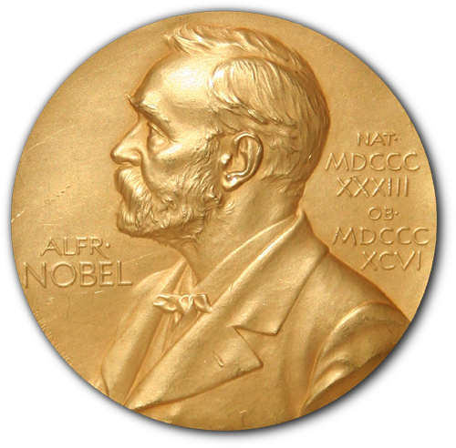

From Nobels to STEM
Where did women go?

Slide 2



The Nobel Prize
572
Medicine
12
18
Chemistry
Physics
115 years
1901
2016

Slide 3



Female vs Male ratio
(males / 100 females)
< 104:100
~ 100:100
24:100
Females in the age of tertiary education: 48%

Slide 4



What do females want to study?
SUM OF ALL 4:
19’39 %
21.74 %
21.09 %
56 %
Female graduates
STEM
13.39 %

Slide 5
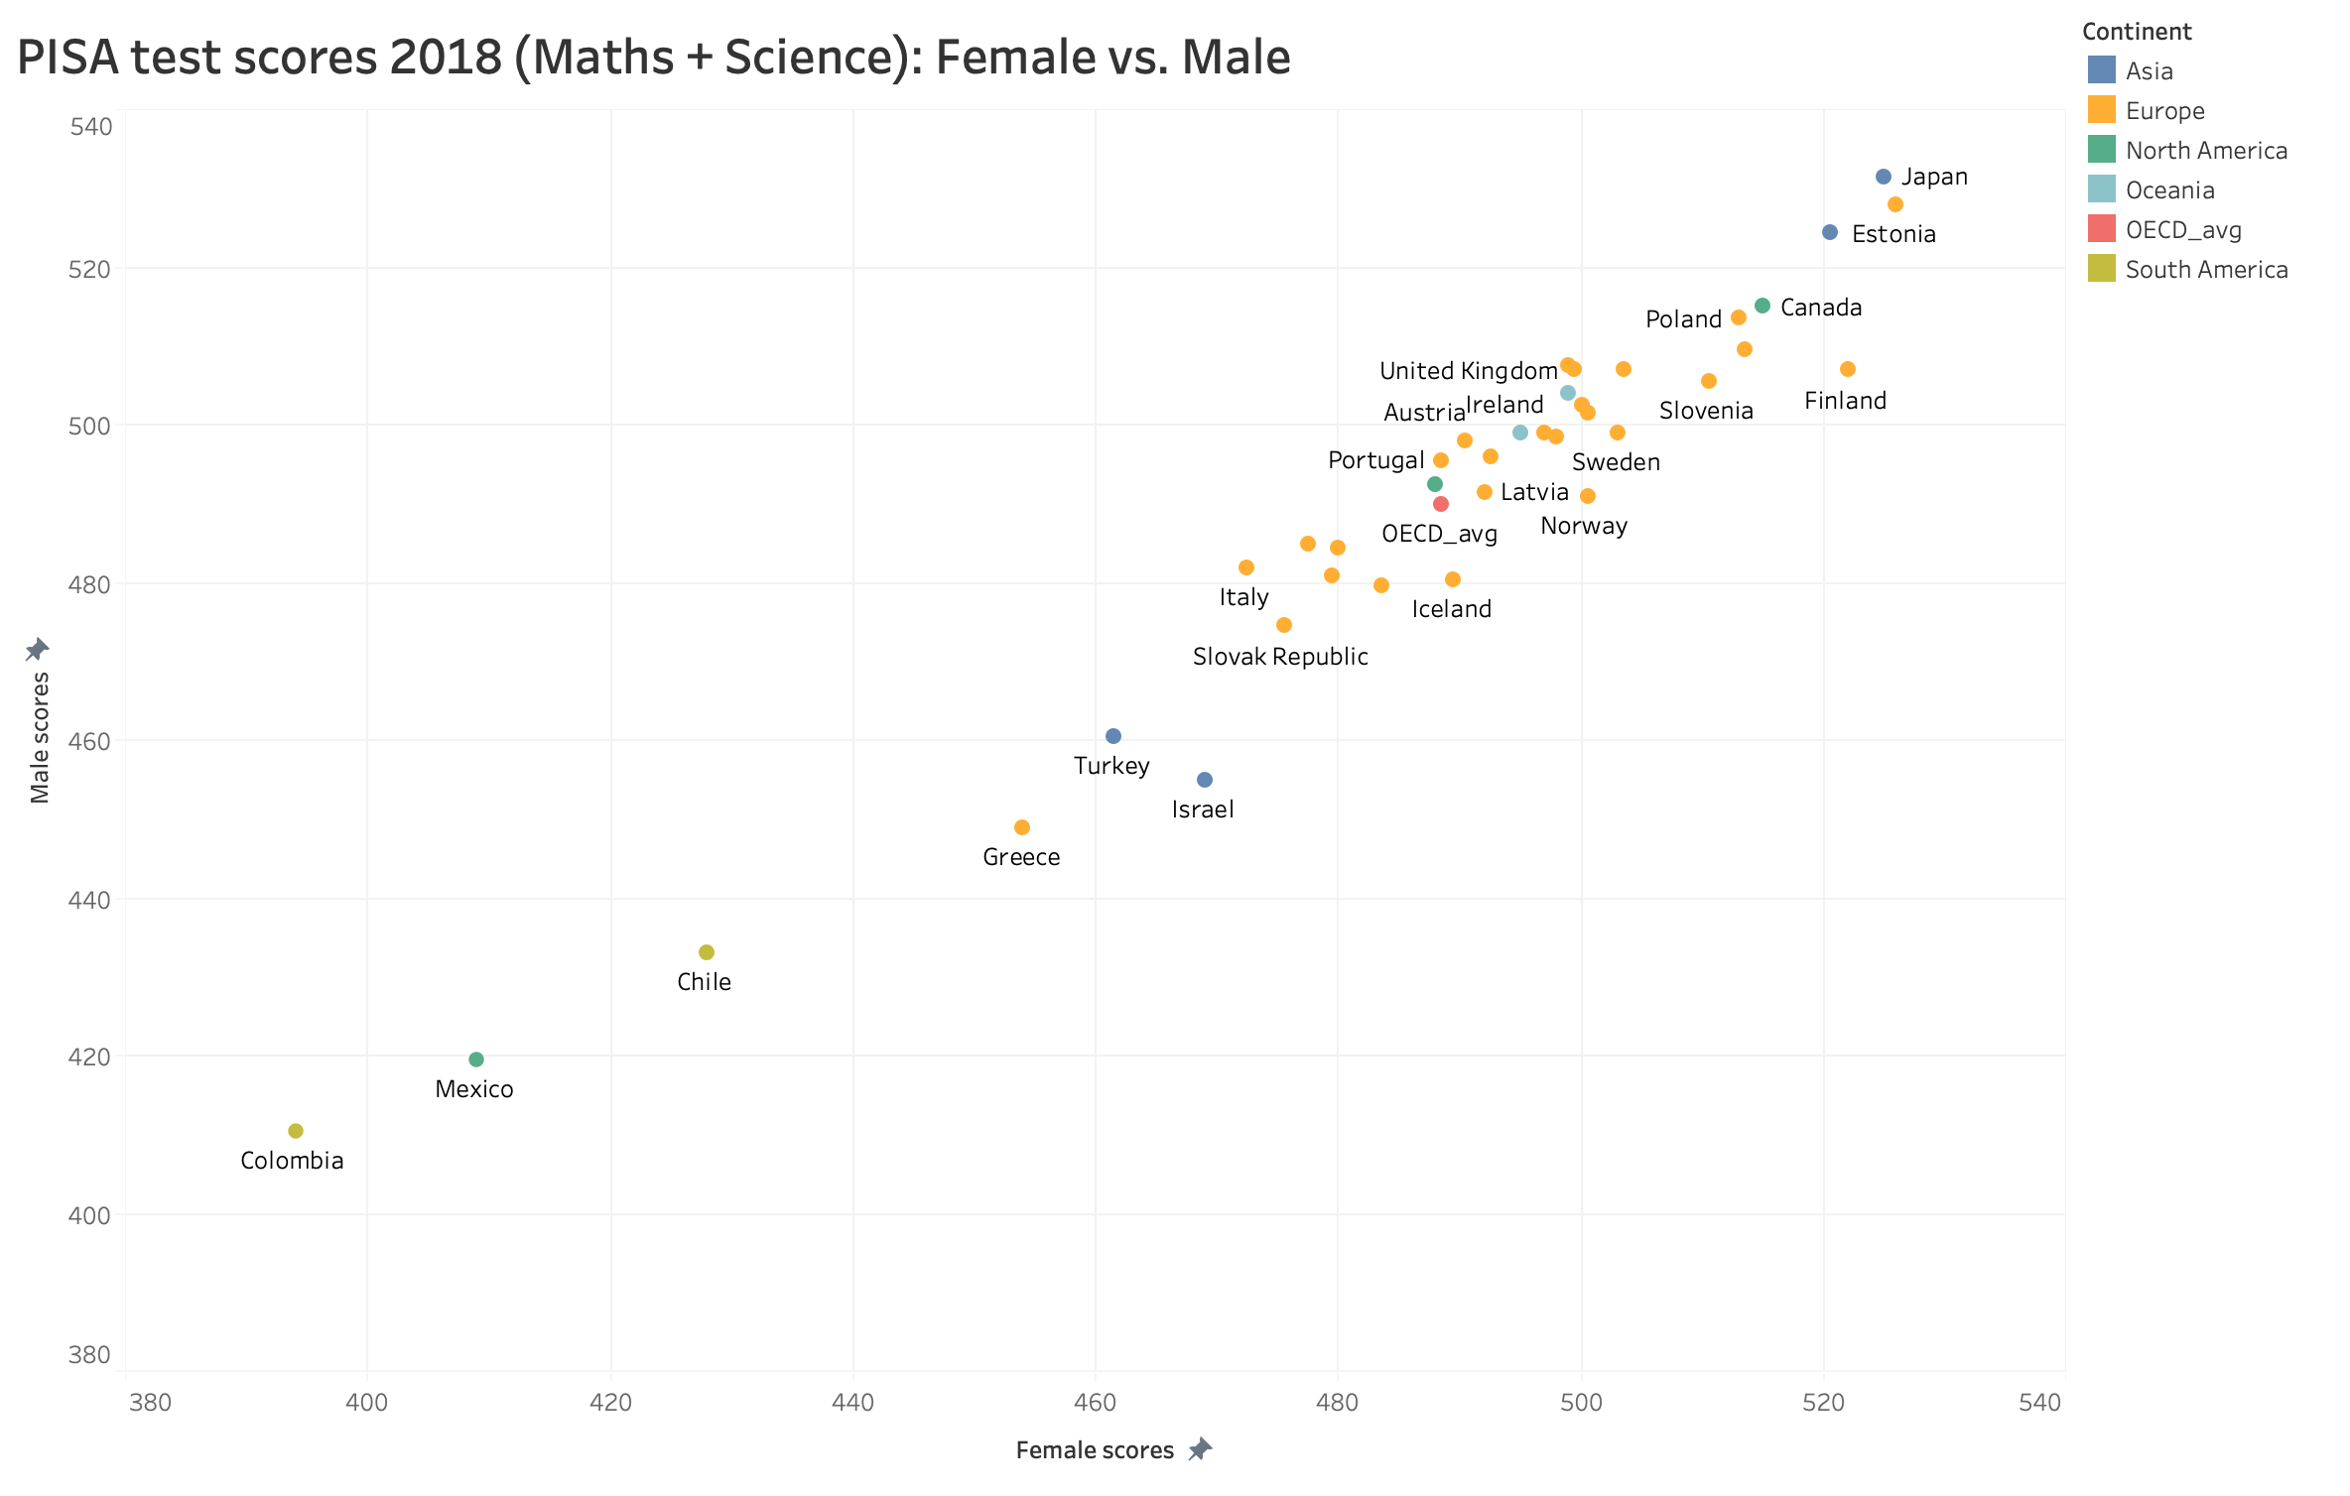
Is there a gender performance difference?
Variance could be due to:
EXAM PRESSURE
NOT a significant difference
Nature vs. Nurture
(Genes) (Environment)
Culture
Society
Source: https://pisadataexplorer.oecd.org/ide/idepisa/

Slide 6
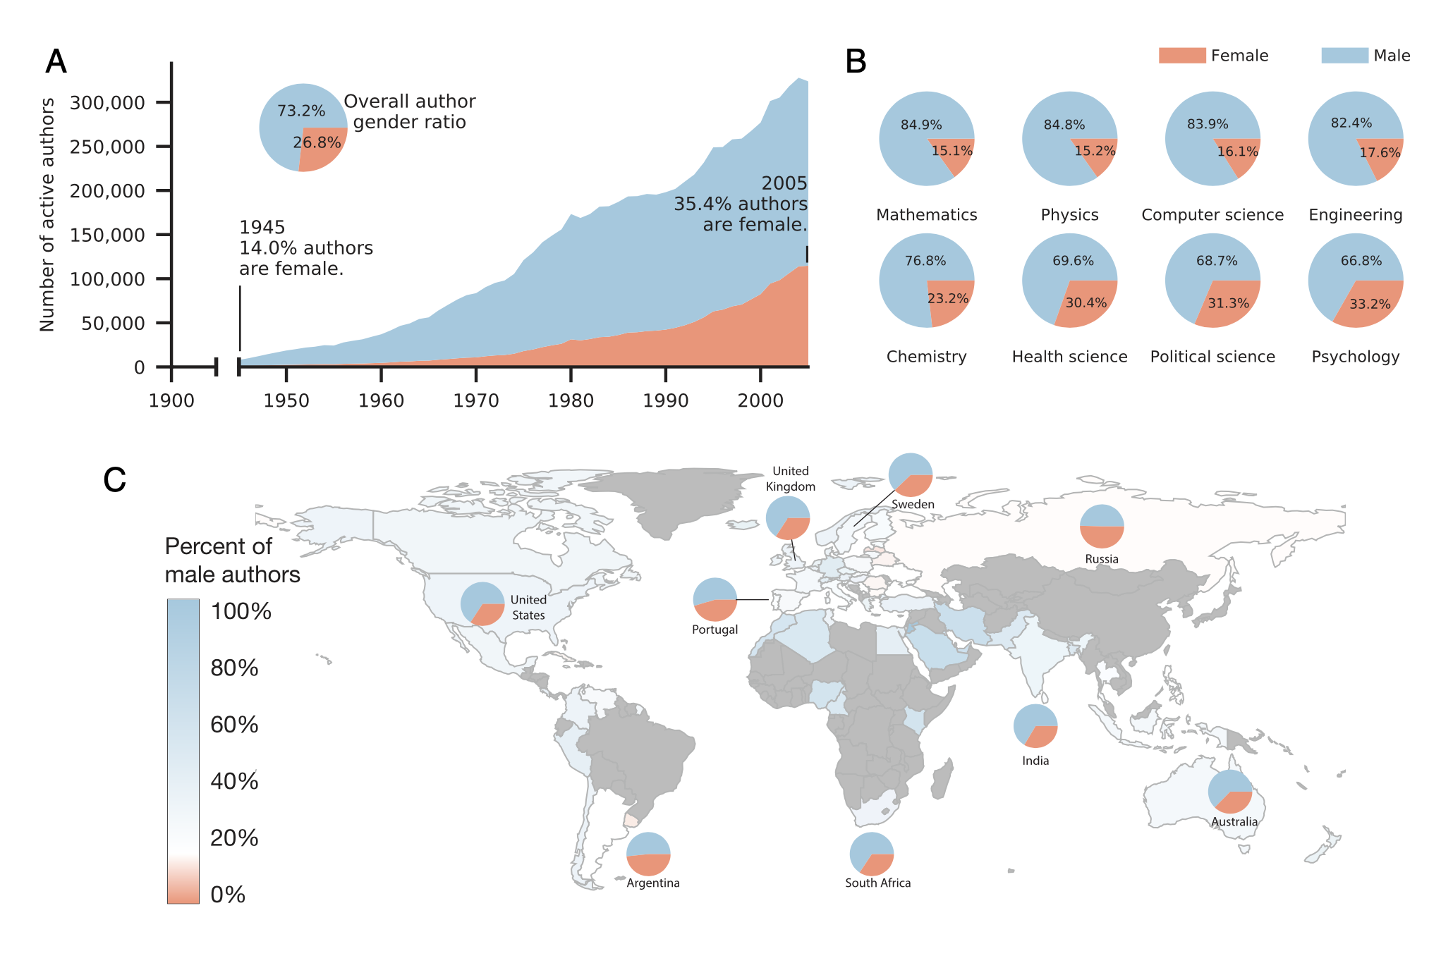
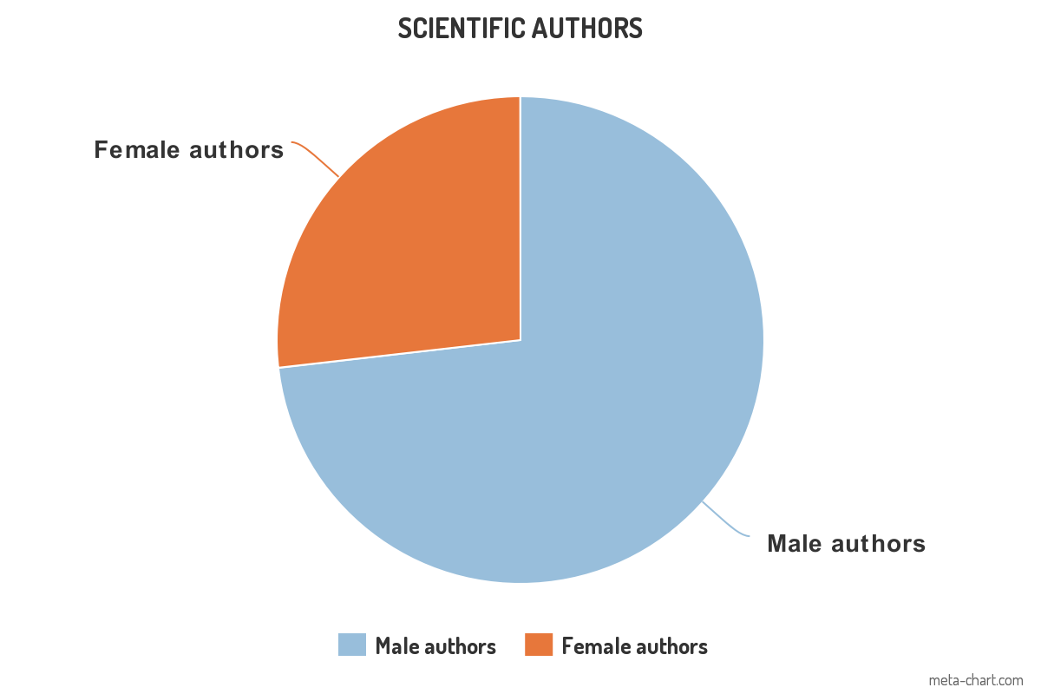
Why aren’t there more Medicine female winners?
FEMALE
Scientific authors
26.8%
Before a nobel:
RESEARCH
and
PUBLISH
73.2%
MALE
Source: Huang, J., Gates, A. J., Sinatra, R., & Barabási, A. L. (2020) & Eagly, A. H. (2020)
Notes:
Eagly, A. H. (2020). Do the social roles that women and men occupy in science allow equal access to publication?. Proceedings of the National Academy of Sciences, 117(11), 5553-5555.
Huang, J., Gates, A. J., Sinatra, R., & Barabási, A. L. (2020). Historical comparison of gender inequality in scientific careers across countries and disciplines. Proceedings of the National Academy of Sciences, 117(9), 4609-4616.

Slide 7




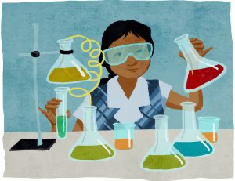
What can we do? Is there a solution?
Change sociocultural gender views

Slide 8

Thank you for listening

